Slide 1

Mini Project Presentation On ROAD ACCIDENT DETECTION
By
• T.Mythili(21WJ1A05W0)
• T.Vamshi krishna(21WJ1A05W3)
• V.Mounika(21WJ1A05X9)
Under the Esteemed Guidance of
Mr.MANAN RASOOL
Guru Nanak Institutions Technical Campus (Autonomous)

Slide 2

OVERVIEW of the Presentation:-
Abstract
Objective
Introduction
Literature survey
Existing System
Proposed System
System Architecture
Conclusion

Slide 3
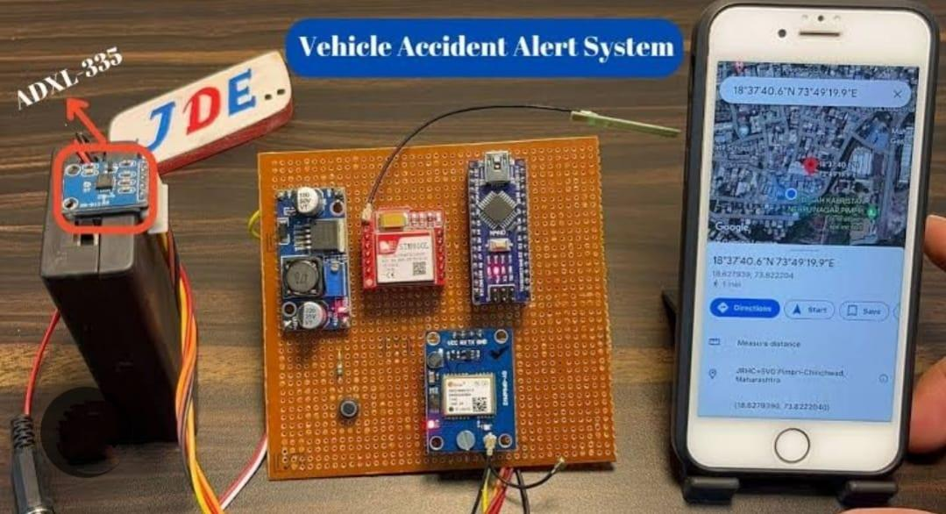
ABSTRACT:
Efficient Accident Detection System Growing Need: Increasing number of accidents highlights the demand for efficient detection systems. Traditional Method: Uses accelerometers to measure acceleration (g) values. Limited by the accuracy of the accelerometer. Proposed Solution: Incorporate Convolutional Neural Networks (CNNs) for improved accident detection. CNNs excel in image classification but require significant time, data, and computing resources. Transfer Learning: Mitigates challenges of CNNs by retraining pre-trained networks. Inception-v3 model, developed by Google, utilized fResults application. Results: The proposed system achieves an accuracy of 84.5%.

Slide 4
OBJECTIVES:
Primary Objectives: Enhance Safety: Improve road safety through timely and accurate accident detection. Accelerate Response: Reduce the response time for emergency services through automation. Minimize Impact: Decrease damage and injuries resulting from accidents.
Increase Awareness: Provide situational awareness for drivers and authorities.
Specific Objectives: Rapid Detection: Detect accidents within 1-2 minutes of occurrence using Python-based algorithms. High Accuracy: Achieve detection accuracy rates of 90% or higher. Minimize Errors: Reduce false positives and negatives in detection. Performance Metrics: Detection Accuracy: Measure the percentage of accurately detected accidents. Response Time: Track the time taken for alerts to reach emergency services. False Rates: Monitor the rates of false positives and negatives. Technical Requirements:
Hardware: Utilize sensors and cameras compatible with Python. Software: Leverage Python libraries for machine learning (e.g., scikit-learn, TensorFlow).

Slide 5
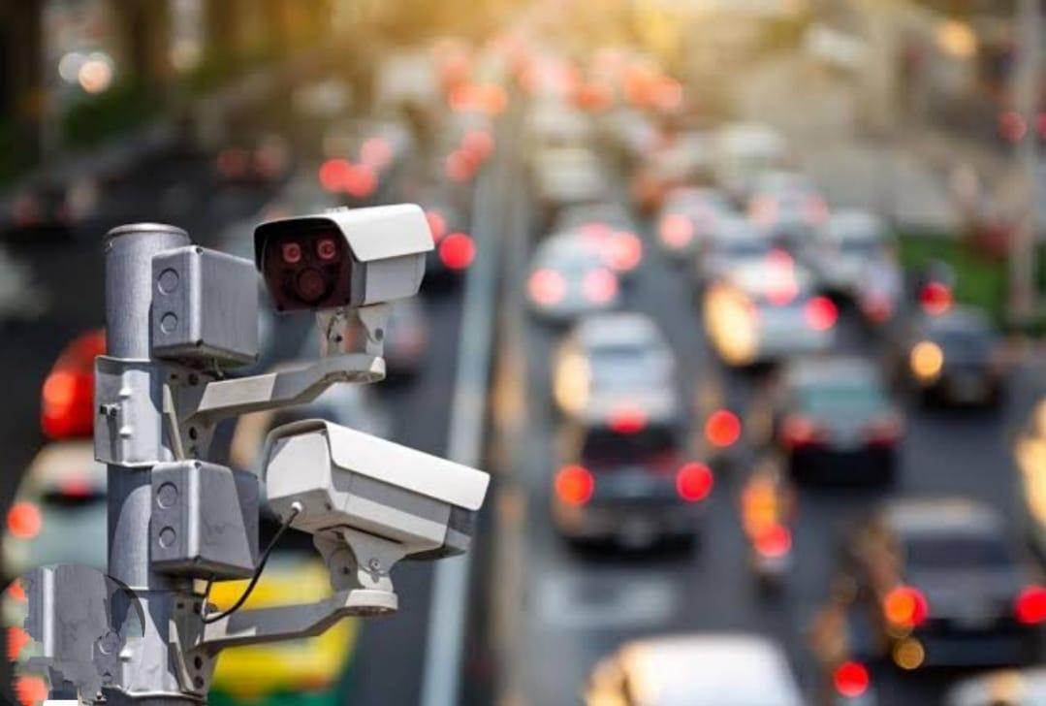
INTRODUCTION:
Accident detection systems are crucial for enhancing road safety and improving emergency response. With the increasing volume of traffic globally, timely and accurate detection of accidents has become essential to minimize injuries, fatalities, and economic losses associated with road incidents.
Road accidents are a significant global concern, leading to severe injuries, fatalities, and economic losses. With the increasing number of vehicles on the road, the need for efficient and effective accident detection systems has become paramount. Leveraging technology can greatly enhance our ability to detect accidents in real-time.
Python, a versatile programming language, has emerged as a powerful tool for developing such detection systems. Its rich ecosystem of libraries and frameworks allows for seamless integration of various technologies, such as computer vision, machine learning, and data processing.

Slide 6
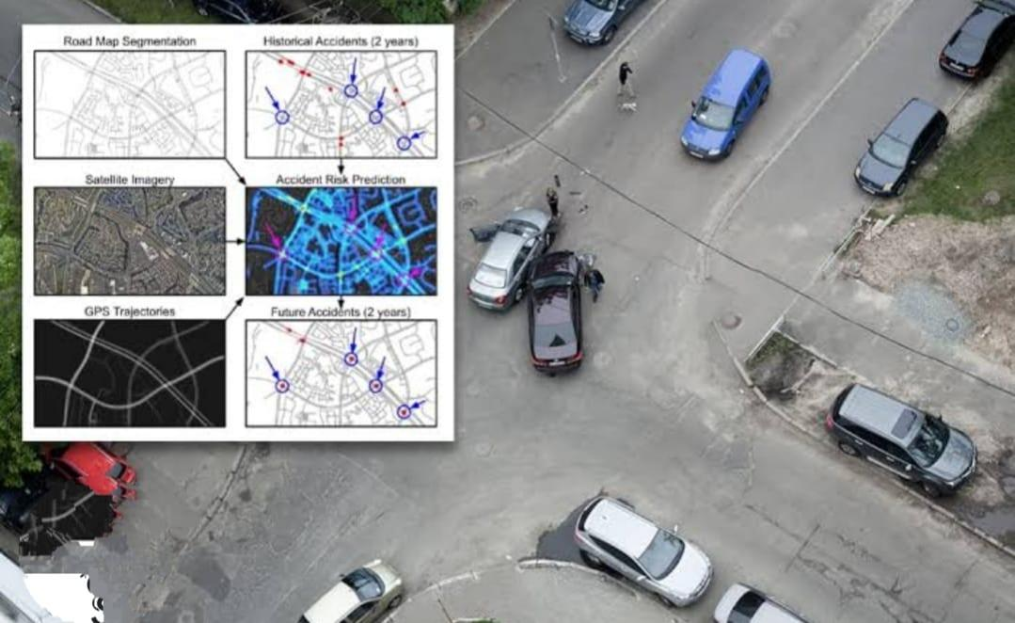
LITERATURE SURVEY-I:
Title: Road accident detection
Author: Praharshasarma, M. Vasimbabu
Description:
Automatic Vehicle Accident Detection and Rescue System
In this paper, it is realized that the rate of deaths related to
vehicle accidents is very high. So, they have proposed a
system where it detects accidents in less time and then
sends the message to the nearest emergency services. In
this, the accident is detected with the help of the Micro
Electro Mechanical System (MEMS) sensor and Vibration
sensor. The MEMS sensor even helps to determine by what
angle the car has rolled over. The message is then sent through
with the help of the GSMModule which collects the
geographical location of the accident site.

Slide 7
LITERATURE SURVEY-II:
Title: Road accident detection
Author:C.N.S.Vinoth kumar
Description:
Tracking and Accident Detection and Alert System A solution is achieved in this paper, by introducing an automatic alert system. The main objective is to reduce the number of deaths occurring due to road accidents. This is achieved by sending a message to the nearest medical Centres and registered mobile numbers with the help of the GSM module. The vibration sensor used here will be activated when it feels some anomaly in the readings and The message is then transferred to the registered number. The GPS module used in the system will help provide the Geographical location of the accident site.

Slide 8
EXISTING SYSTEM:
Accidents have been a major cause of deaths in India. More than 80% of accident-related deaths occur not due to the accident itself but the lack of timely help reaching the accident victims. In highways where the traffic is really light and fast-paced an accident victim could be left unattended for a long time. The intent is to create a system which would detect an accident based on the live feed of video from a CCTV camera installed on a highway. The idea is to take each frame of a video and run it through a deep learning convolution neural network model which has been trained to classify frames of a video into accident or non-accident.

Slide 9
EXISTING SYSTEM ALGORITHM:
Convolutional Neural Network (CNN) CNNs are used in modelling spatial data like images. CNNs have been successful in tasks like image classification, object detection, etc. LSTMs are used to model sequential data and make predictions based on them. LSTMs are widely used in areas of text classification, making language models, sequence generation, etc. Standard LSTMs can be used directly on sequential data where the input is spatial. Thus, to perform tasks which involve sequences of images or videos, CNN-LSTM architecture needs to be used.

Slide 10
PROPOSED SYSTEM:
Convolutional neural network is the state-of-the-art tech-nique in image classification and recognition. It has a stack of convolutional layers, ReLu layers and pooling layers. This is discussed in detail in [10]. Convolutional layer is feature extraction layer which detects from general features like edges to more specific features like objects and colors from the images. Pooling layer reduces the dimensionality. It takes much time and computing power to train such a network and very large image dataset is also required. For example, google’s inception-v3 image classifier is trained on the ImageNet dataset of 100000 images to classify among 1000 classes. It has 22 hidden layers and it took weeks to train it. Transfer learning technique comes in handy to avoid such limitations. Transfer learning refers to using learning from previous training session to a new training session.

Slide 11
PROPOSED SYSTEM ALGORITHM
Transfer Learning Tensor flow running through spyder/python code, we can kept in a car. Inception-v3 trained on training dataset to detect accident. Picture are continuously captured and fed to the program, where it detects whether accident is occurred or not with the Inception-v3. Camera module can be used for this purpose like CV2 i.e., computer vision module. Inception-v3 is used for our image classification problem.

Slide 12
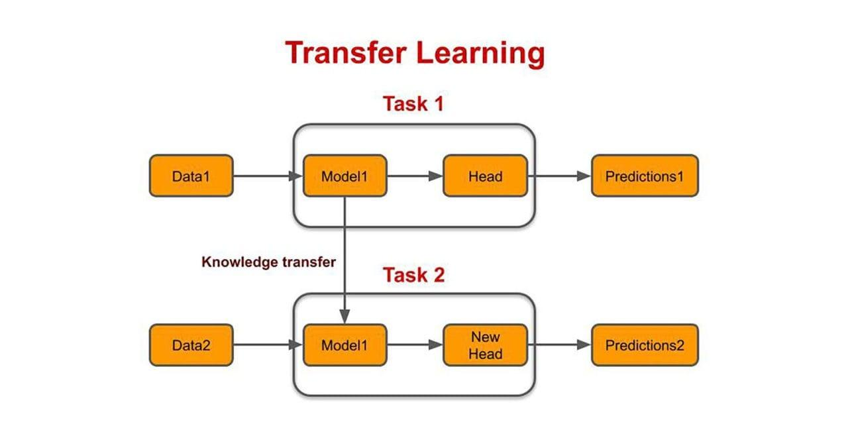
SYSTEM ARCHITECTURE:

Slide 13
SYSTEM REQUIREMENTS
HARDWARE REQUIREMENTS PROCESSOR : Pentium i3 Processor RAM : 2GB DD RAM HARD DISK : 250 GB SOFTWARE REQUIREMENTS BACK END : PYTHON OPERATING SYSTEM : WINDOWS 7 IDE : Spider3

Slide 14
Conclusion
In conclusion, road accident detection using Python can significantly enhance public safety and response efficiency. By leveraging machine learning and computer vision techniques, systems can analyze traffic data and images in real-time to identify potential accidents. Key benefits include rapid incident detection, reduced response times for emergency services, and the potential to inform traffic management systems. Implementing such a system involves integrating data from various sources, such as cameras and sensors, and utilizing algorithms for image processing and anomaly detection. The development of user-friendly interfaces for real-time alerts and data visualization further improves the system’s effectiveness

Slide 15
Thank You

